Slide 1
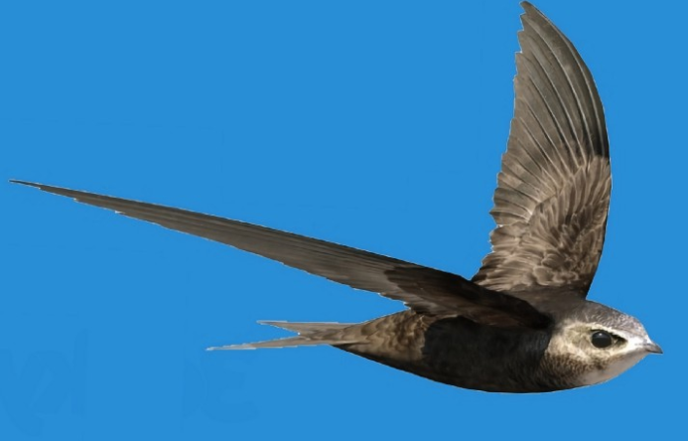
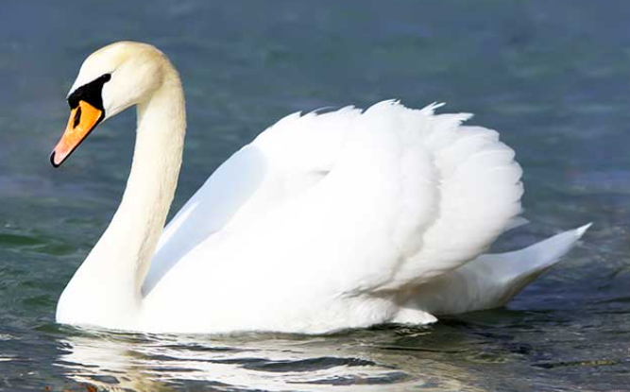
Getting to know you meeting
Key stage 1

Slide 2
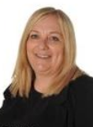
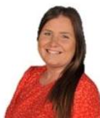
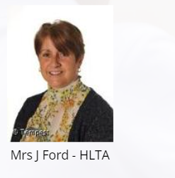
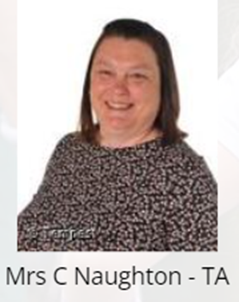
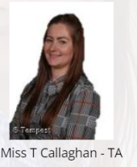
Meet the Staff
Miss Lees Miss Craig

Slide 3
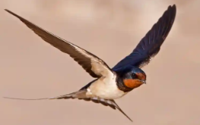
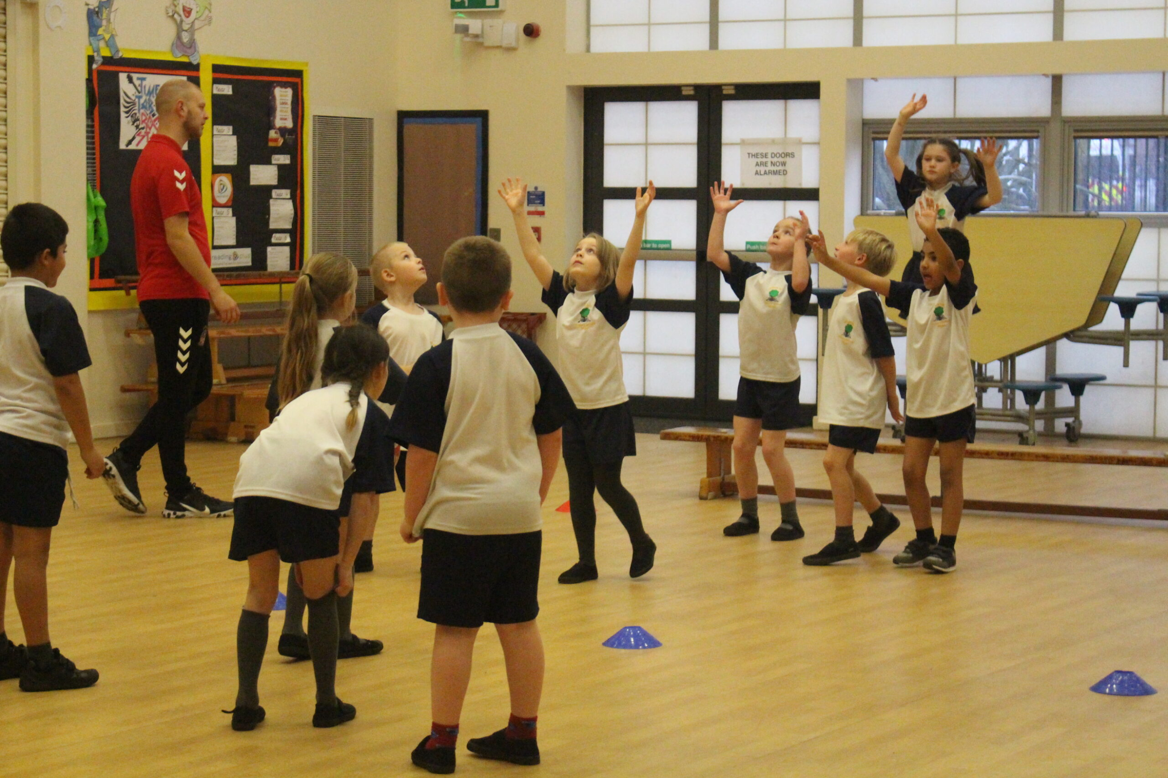
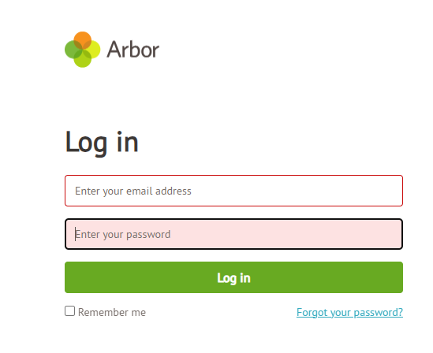
Important information…
P.E. Tuesday Wednesday
Sign up to Arbor.
Please speak to the office if you
have any questions.
Si

Slide 4


Working together as a school
At Beech Hill Primary School we want the very best for our children
Reading is a focus for our school and it is important that children have the opportunity to read as often as possible.
A wide variety of fantastic books are available in class libraries.
We even have some comics and magazines too! (we want to make reading fun!)
To help us in our quest for excellent please listen to your child read at home and make sure their diary is signed
Please complete all of the information in your child’s journal.

Slide 5
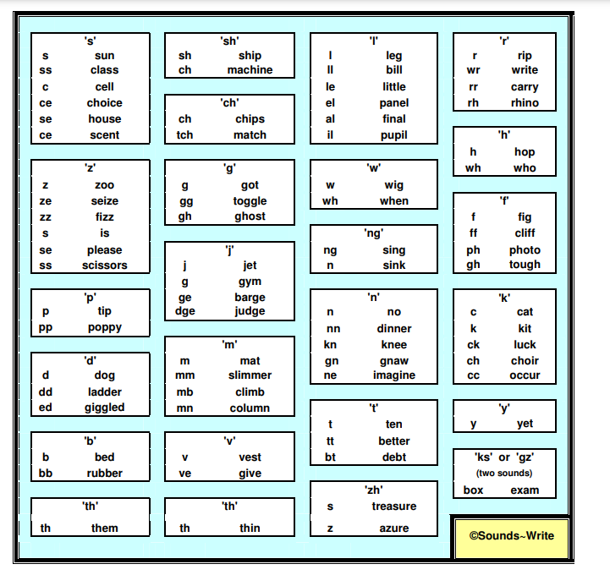
Sounds Write
Children will take part in a daily Sounds Write lesson.
Children are taught that letters are symbols for sounds
When we see < m > < a > < t >, they say and hear /m/ /a/ /t/ 'mat'.
Sounds need to be said very precisely e.g. we say /m/ and not 'muh'.
Sounds Write

Slide 6
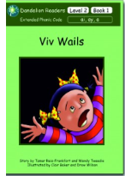
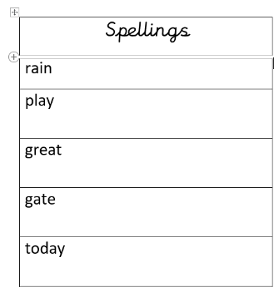

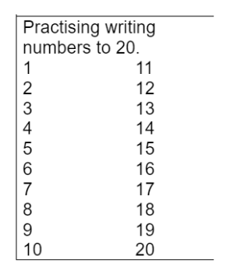
Homework
Reading Book
Spellings to learn
Number activity
Sharing book

Slide 7
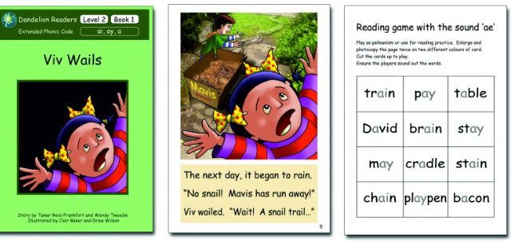
Reading books
Children will bring home a book linked to the sounds that have been taught in the previous weeks Sounds Write sessions.
Monday - Read the sounds/words in the book and use the photocopied sheet to play the game.
Tuesday - Read the book and discuss.
Wednesday - Children read the book and then answer the comprehension questions.
Thursday - Return the book ready for a new book to be issued on Friday.

Slide 8
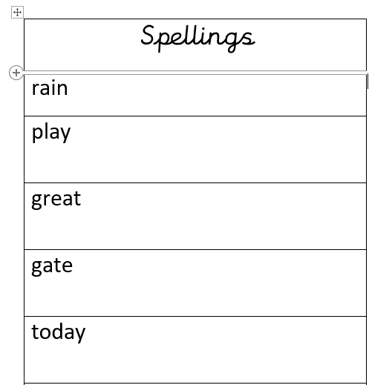
Spellings
Children will have spellings stuck into their reading journal every Friday.
Spellings will be linked to the sounds that have been taught in their Sounds Write lessons.
Children should practise reading and writing the words.
Children have a spelling test each week.
Say the sounds in the word
Read the word
Write the sounds
Check the spelling

Slide 9
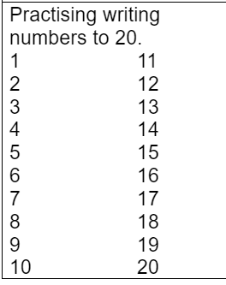
Number Work
Children will have a number activity stuck into their reading journal each week.

Slide 10
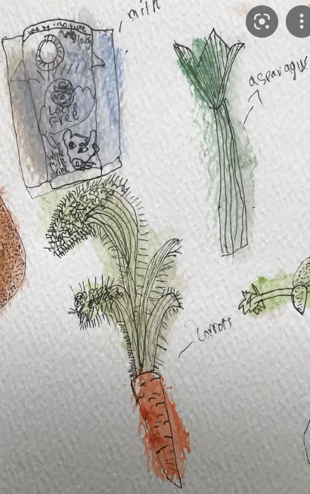
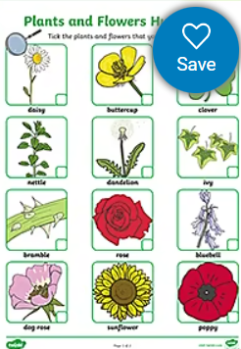
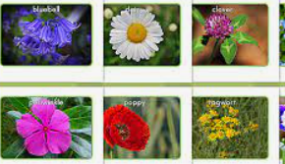
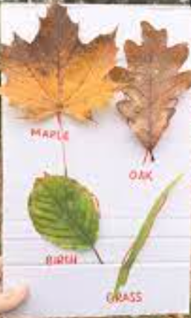
Learning Log
Children will bring home a new homework activity each week.
The tasks should be completed with an adult and should be fun and creative.
This week the learning log will be:
Can I find out what is growing in my garden?
Take photographs
Draw and label pictures
collect leaves or plants and stick in your learning log
Tick sheet

Slide 11

Google classroom
Google classroom was an invaluable tool during lockdown and it is important that your child is able to access their virtual teaching space.
Please practice logging on at home
(log in information can be found in reading diaries)
Some homework activities will be set on the platform
If your child has a problem logging in please let us know

Slide 12

Behaviour policy
Please check and sign the home school agreement in the reading diary
Track it lights
All children are in a house
Billinge, Parbold, Rivington, Winter
House points mean PRIZES!
As well as accumulating points for their house, children will accumulate points for themselves and then trade them in for prizes. The can trade points when they meet a threshold, if they save them up they can get a bigger prize!

Slide 13
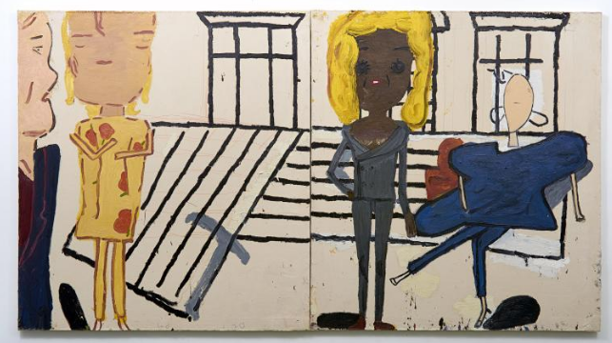
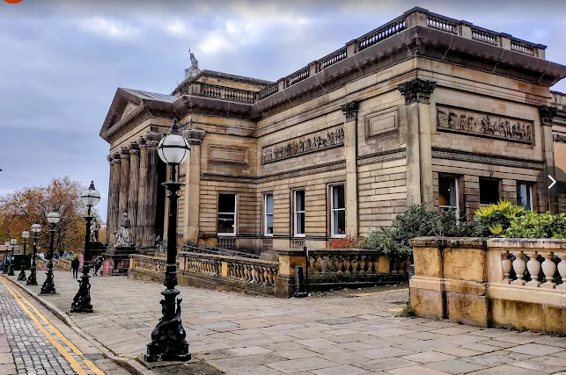
School Trip

Slide 14

Any questions?
Remember we are available at the door most mornings and afternoons if you have a query or concern. If you need to speak in more depth then you can make an appointment.

